Slide 1
Interactive Time Series Exploration Powered by the Marriage of Similarity Distances
Rodica Neamtu, Ramoza Ahsan, Elke Rundensteiner, Gabor Sarkozy
Worcester Polytechnic Institute
Worcester, MA, USA
PVLDB 2016

Slide 2
Outline
Motivation
Contribution
Algorithm & Details
Experiments

Slide 3
Motivation
Notes:
尽量简单 for 4 difficulties！！！

Slide 4
Motivating Examples
In 2013 in Massachusetts, organizations set out to repeal the Sales and Use Tax on computer and software services, perceived as potentially having a negative impact on the economic health of the state.
Difficulty 1: Slow Computation
Data from different domains requires comparison of time series of different lengths and alignments.
DTW -> robust, accurate, but slow (because of high computational complexity)
Difficulty 2: Incomplete Time Series Data
Analyst uses growth rate to evaluate the potential impact of the tax and searched for matches among all states.
Some time series data for some states may not exist
Difficulty 3: Unecessary Complex Questions
Searching for recurring similarity patterns
Difficulty 4: Redundant Computations for Much Parameter Settings
Data from diverse domains requires the use of different parameter settings
Notes:
让我们考虑一个现实生活中的例子，揭示寻找和利用数据相似性进行决策所涉及的挑战。 2013年在马萨诸塞州，各组织开始废除计算机和软件服务的销售和使用税，被认为可能对国家的经济健康构成负面影响。分析了数据驱动的证据，显示了从大量公共政府网站获得的税率与时间的关系，以及社会和经济因素的波动，都以时间序列为模型。遇到了很多困难，其中主要是寻找和解释以时间序列表示的经济指标之间的相似之处的时候。
来自不同领域的数据的存在通过特定间隔报告需要比较不同长度和比对的时间序列，因为税收变化的影响可能会持续不同的时间段变得明显。这种时间感知比较必须使用像“动态时间扭曲”（DTW）这样的漫反射距离进行[5]。这些措施的“权力”在准确性方面是有益的，它们的计算复杂度受到影响，因此即使对于中等大小的数据集也是缓慢的时间响应。在此过程中，分析师使用具体指标，如增长率，评估引入新税收的潜在影响。例如，他们“设计”一个示例增长率时间线，表示税收的积极影响，并搜索所有州之间的匹配。在这种情况下，序列可能存在或可能不存在于数据集中。完美匹配，如果发现，反映了这些特定国家的类似影响，而紧密匹配表明具体国家的影响略有不同。因此，分析人员需要通过使用这些数据集中可能存在或可能不存在的样本序列来探索大型时间序列数据的能力。
分析人员不得不回答复杂的问题，这些问题不一定基于找到最佳匹配顺序。例如，他们搜索周期性的相似性模式，例如几年的国家增长率以及类似的增长率以及不同状态下的特定时间长度的其他经济指标，表明类似的“短期”影响。来自不同领域的数据需要使用不同的参数设置，例如相似性阈值，导致每个参数设置的重复和冗余计算。例如，用于研究人口统计数据相似度的最适合阈值与用于增长率的阈值不同。

Slide 5
Contribution

Slide 6
Contribution
Precompute similarity groups
Fast
In-memory Index
Interactive
Group representatives
Accurate
Triangle inequality between ED and DTW
Others
Parameter tuning guidance

Slide 7
Algorithms & Details

Slide 8
Theoretical Foundation

Slide 9
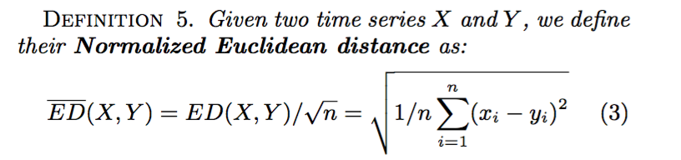
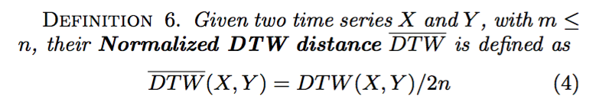
Preliminaries
Normalized Euclidean Distance
Normalized DTW Distance

Slide 10
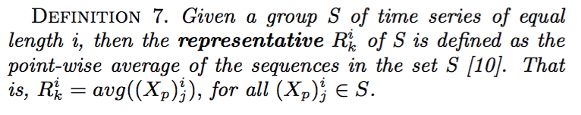
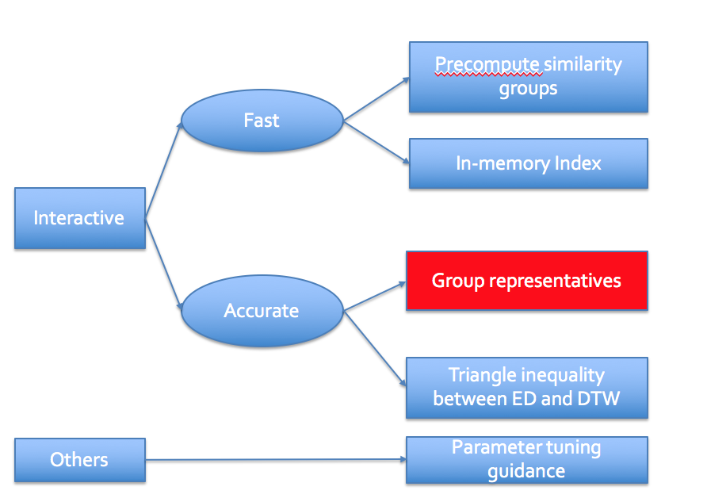
Define ONEX Similarity Groups
Representative of a group

Slide 11
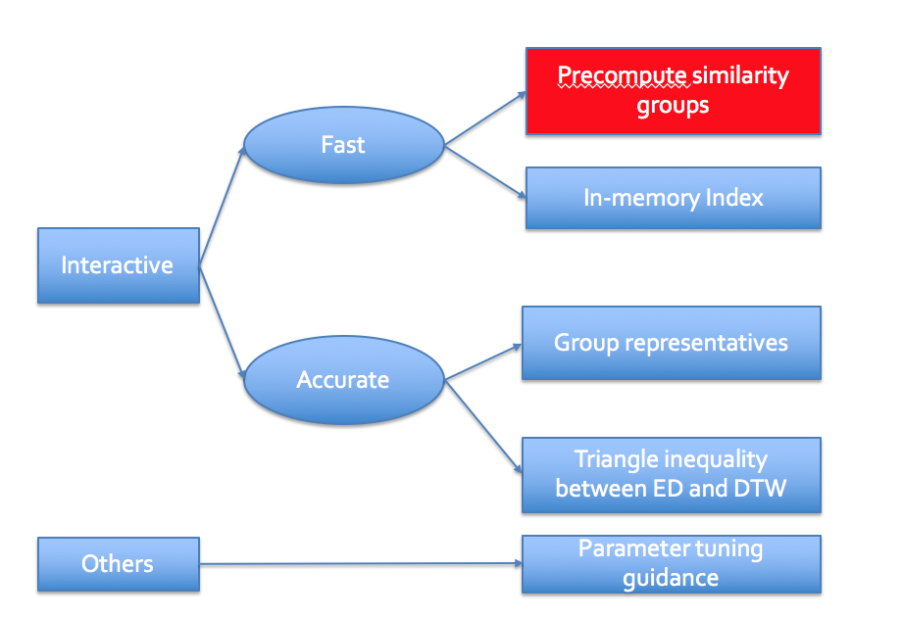
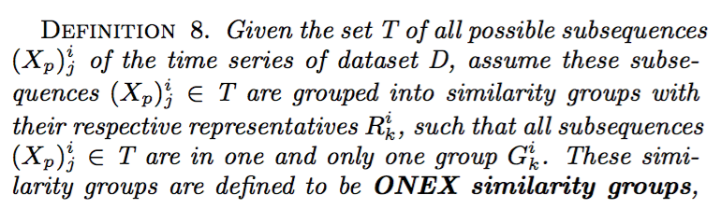
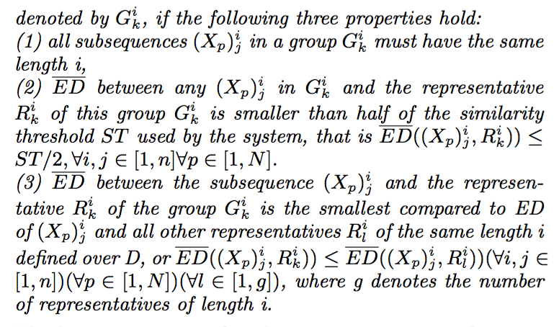
Define ONEX Similarity Groups
ONEX similarity groups
Notes:
放点红框框，放个例子，Group要提前提一下

Slide 12
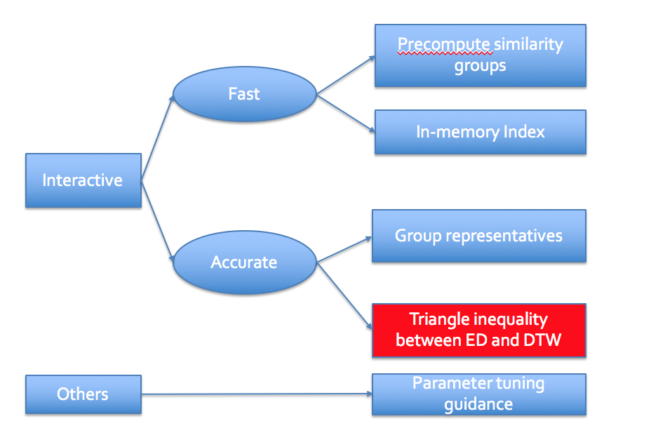
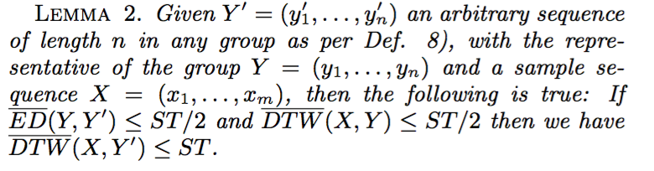
ED-DTW Triangle Inequality
Rodica Neamtu, Ramoza Ahsan, Elke A. Rundensteiner, Gábor N. Sárközy:
Interactive Time Series Exploration Powered by the Marriage of Similarity Distances. PVLDB 10(3): 169-180 (2016)
Section 3.2
Notes:
简洁的话概括证明，或者列reference，论文中的第几段，把basic idea介绍出来

Slide 13
Offline: ONEX Base
Notes:
框架图！！

Slide 14
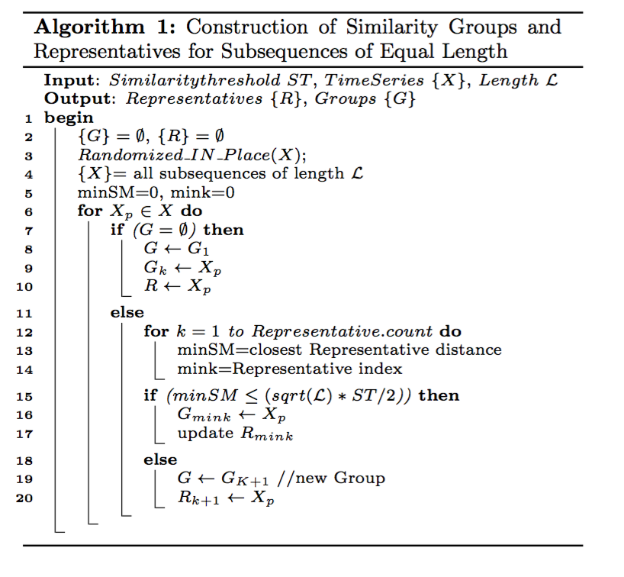
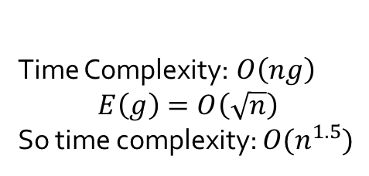
ONEX Base Construction
Randomize algorithm
Decrease time complexity from O(n^3) to O(n^1.5)
Time Complexity:$O\left(ng\right)$
$$E\left(g\right)=O\left(\sqrt{n}\right)$$
So time complexity: $O(n^{1.5})$

Slide 15
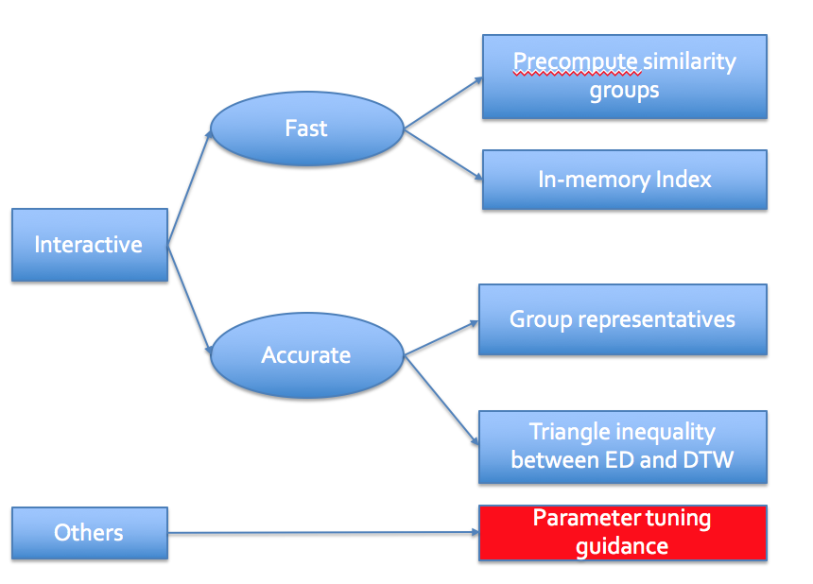
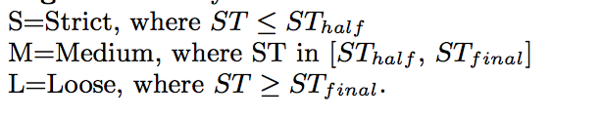
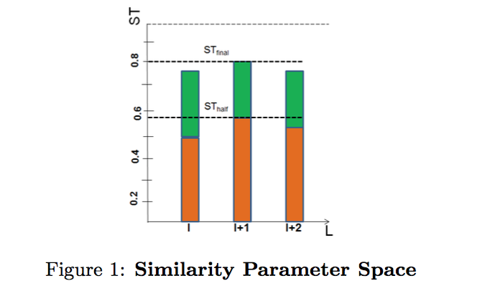
Parameter Tuning Guidance
Three similarity degrees

Slide 16
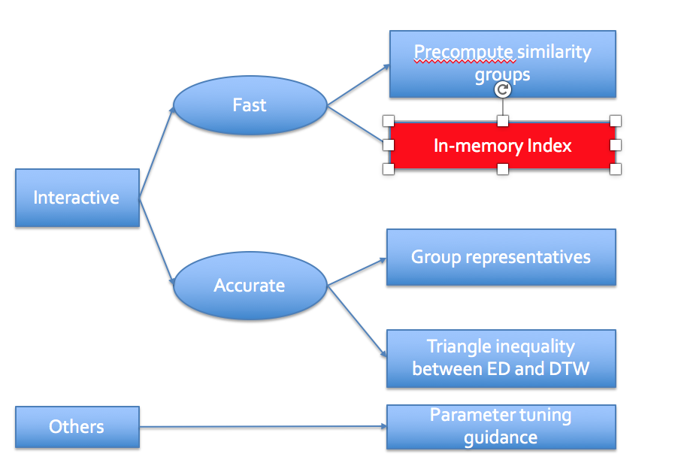
Storage and Indexing
Global Time Index (GTI)
Array indexed by length.
For quick retrieval of the set of groups for each specific length.
Local Sequence Index (LSI)
Containing the representatives of groups
Used to find “best matching sequence” in “selected group”

Slide 17
Online: ONEX Online Query Processor
Notes:
例子！！

Slide 18
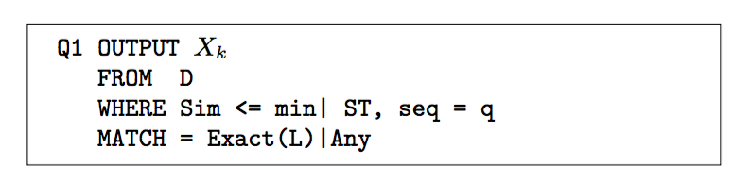
ONEX Queries Classes
Class 1: Similarity Queries
Formulation
Use case
OUTPUT Xk
FROM D
WHERE Sim <= ST, seq = Apple
MATCH = 10 days | Any
Notes:
解释query语句，结合语句讲use case，加例子

Slide 19
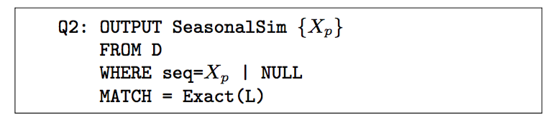
ONEX Queries Classes
Class 2: Seasonal Similarity
Formulation
Use Case
OUTPUT {Xk}
FROM D
WHERE seq = Apple
MATCH = 30 days

Slide 20
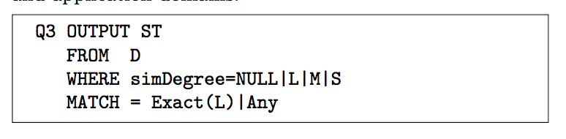
ONEX Queries Classes
Class 3: Similarity Threshold Recommendations
Formulation
Use Case
OUTPUT ST
FROM D
WHERE simDegree = S
MATCH = 30 days

Slide 21
Query Processing over ONEX Base
Class 1: Similarity Queries
LSI Inner-search
Most similar time series
Time Series Indexes
GTI Index
Groups with length i
LSI Index
Most similar group
Notes:
例子+流程图

Slide 22
Query Processing over ONEX Base
Class 2. Seasonal Similarity Quries
Time Series Indexes
GTI Index
Groups with length i
All groups
Inner-search
Most similar subsequences in all group

Slide 23
Query Processing over ONEX Base
Class 3: Similarity Threshold Recommendations
ST in pre-processing groups
If ST’ < ST, then divide groups
If ST’ > ST, then merge groups

Slide 24
Optimization of Processing Queries
For GTI Searching
Greedy
For a given sample sequence of length L, we start the search for the best match representative with the ones of the same length as the query.
If we don’t find the “best match” representative for this, we continue by searching the representatives in decreasing order of their length.
Divide and Conquer
We find the “median representative” and start our search with this representative.
We follow up by alternately checking the closest representatives to its left and then right in the index, until we reach the best representative.
For in-group Searching
Greedy
Find the sequence in the group whose ED to the representative has the closest value to the DTW between given sequence and the representative.

Slide 25
Experiments

Slide 26
Settings
Datasets
From UCR time-series collection
Performance Statistics
The online query processing time and accuracy are reported for queries averaged over multiple runs.
Evaluating the ONEX base by measuring the size and the preprocessing time of our pregenerated information when varying both datasets and similarity threshold ranges.

Slide 27
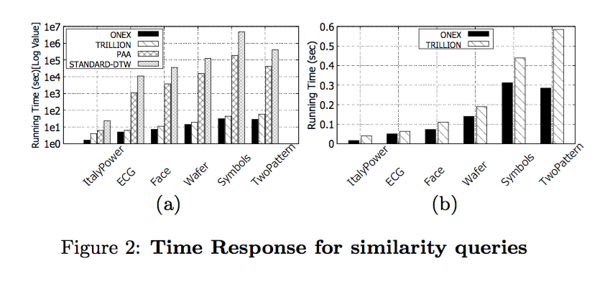
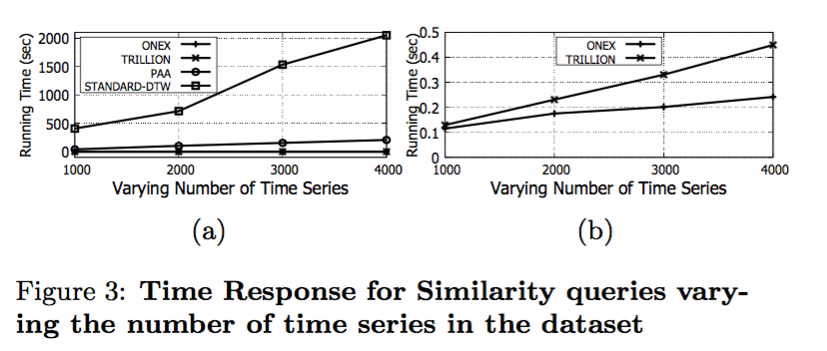
Query Processing Time & Accuracy
Similarity Queries

Slide 28
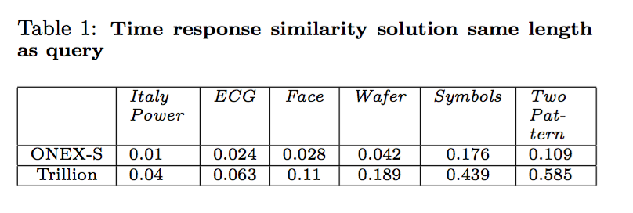
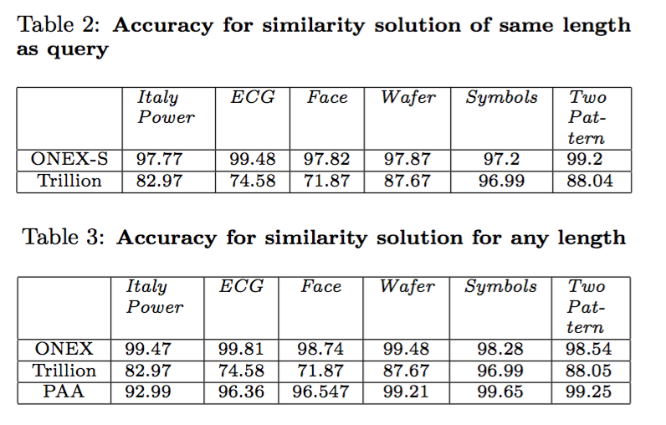
Query Processing Time & Accuracy
Similarity Queries
Notes:
对比试验提一下

Slide 29
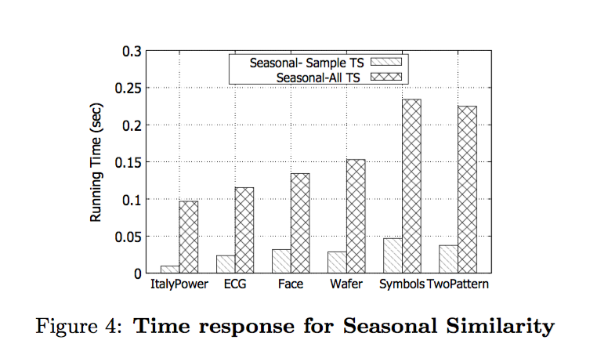
Query Processing Time & Accuracy
Seasonal Similarity Queries

Slide 30
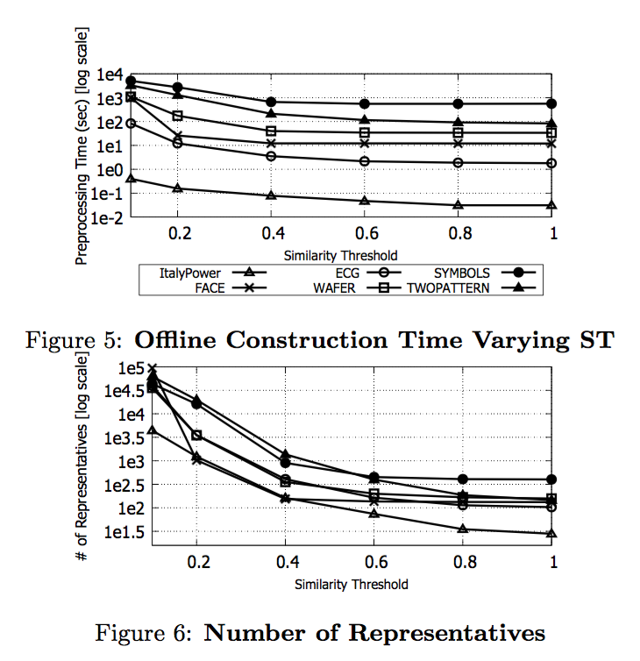
Preprocessing Performance

Slide 31
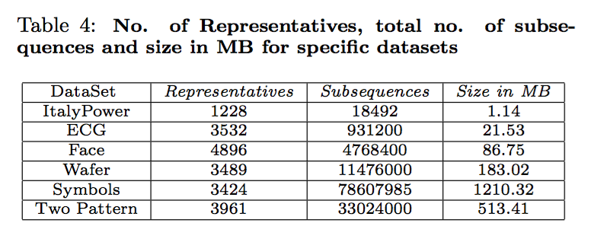
Preprocessing Performance

Slide 32
THANKS

